Slide 1

66
Sixty Six years of professional excellence
Notes:
1
03/11/2011
Thiagarajar College of Engineering

Slide 2
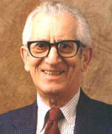


Effective Assessment using Revised Bloom’s Taxonomy
By
Dr.S.BASKAR, BOYSCAST Fellow
Dean (R&D), Professor of EEE Department
Thiagarajar College of Engineering, MADURAI

Slide 3
Session Outcomes
  After the successful completion of the session, Participants will be able to:
  Appreciate the role of Blooms Taxonomy in assessment
  Explain the coverage of three domains of learning in education
  Explain the classification of Cognitive domain of learning in BT and RBT
  Explain the classification of affective domain of learning
  Explain the classification of psychomotor domain of learning
  Select the appropriate assessment tools for assessing different levels of knowledge

Slide 4
Blooms’ Taxonomy
  Reflection: what is the role of Blooms Taxonomy in Teaching and Learning ?
  More authentic tool for curriculum planning, instructional delivery and assessment
Aimed at broader audience
Easily applied to all levels of education

Slide 5
Present Scenario
OBE a performance-based approach has emerged as a major reform model in the global education
NBA and NAAC has made it mandatory for engineering institutions to adapt OBE framework for their curriculum design, delivery and assessment
POs/ PSOs are clearly and unambiguously specified to determine the curriculum content and its organization, the teaching methods and strategies and the assessment process

Slide 6
Present scenario –contd.,
Institutions started adapting OBE framework for their programmes, the focus is limited to the curriculum part, i.e. connecting curriculum components to the POs
Very little attention is being given for connecting examination questions/assessment tools to the program outcomes
absence of proper mapping between program outcomes and assessment tools lead to the inaccurate and unreliable measurement of attainment of outcomes by the students.
This missing connect creates a big gap in the effective adaptation of OBE framework, making the whole exercise futile

Slide 7
Present Scenario –contd.,
Recall of factual knowledge, though essential to any examination, is only one of several major abilities to be demonstrated by the graduates.
Assessment process must also test higher level skills viz. ability to apply knowledge, solve complex problems, analyze, synthesize and design.
Further, professional skills like the ability to communicate, work in teams, lifelong learning have become important elements for employability of the graduates
It is important that the examinations also give appropriate weightage to the assessment of these higher-level skills and professional competencies.

Slide 8
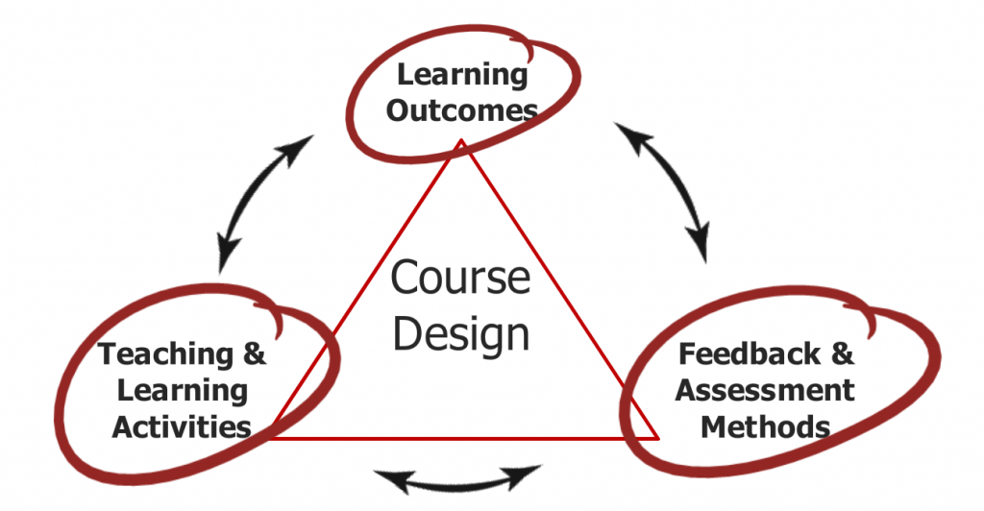
Constructive Alignment
Constructive alignment is a principle used for devising teaching and learning activities, and assessment tasks, that directly address the learning outcomes (LOs).
Constructive alignment was devised by Professor John B. Biggs,

Slide 9
Constructive alignment -Contd.,
Courses are the building blocks of a program.
a “design down” process is employed which moves from POs to Course Outcomes (COs) and outcomes for individual learning experiences
Outcomes at each successive level need to be aligned with, and contribute to, the program outcomes
Teaching strategies, learning activities, assessments and resources should all be designed and organized to help students achieve the learning outcomes at the course level.

Slide 10
Constructive alignment –Contd.,
In the assessment activities, students demonstrate their level of achievement of the course learning outcomes.
In a constructively aligned program, the courses are carefully coordinated to ensure steady development or scaffolding from the introduction to mastery of the learning outcomes, leading to achievement o
For the effectiveness of the program, the achievement of POs is crucial which needs to be proven through accurate and reliable assessments of the intended POs

Slide 11
Need for Examinations Reform
Worldwide adaptation of Outcome-Based Education (OBE) framework necessitates paradigm shift in traditional practices of curriculum design, education delivery and assessment
Reforms are being undertaken to bring about essential changes in engineering education in terms of what to teach (content) and how to teach (delivery) and how to assess ( assessment of learning)
Examinations/student assessments play a very important role in deciding the quality of education.
Quality of examinations (question papers) in Indian engineering education system has been a matter of concern from a long time.

Slide 12
Assessment and Evaluation
All four ABET Commissions have agreed to use common definitions for “assessment” and “evaluation,” as assessment and evaluation are two separate processes.
Assessment : one or more processes that identify, collect, and prepare data to evaluate the attainment of student outcomes. Effective assessment uses relevant direct, indirect, quantitative and qualitative measures as appropriate to the outcome being measured. Appropriate sampling methods may be used as part of an assessment process.
Evaluation : one or more processes for interpreting the data and evidence accumulated through assessment processes. Evaluation determines the extent to which student outcomes are being attained. Evaluation results in decisions and actions regarding program improvement.
https://www.abet.org/accreditation/accreditation-criteria/criteria-for-accrediting-engineering-programs-2024-2025/

Slide 13
Purpose of Assessment
Assessment of instruction,
Assessment for instruction, and
Assessment as instruction
Assessment of instruction :
summative and is especially useful in determining the degree to which a student has mastered an extended body of content or set of LOs at a concluding point in a sequence of learning.
Summative assessments result in grades that should reveal that degree of mastery.
Assessment for instruction :
emphasizes a teacher's use of information derived from assessments to do instructional planning that can effectively and efficiently move students ahead from their current points of knowledge, understanding, and skill.

Slide 14
Purpose of Assessment Cont.,
useful in understanding and addressing students' interests and approaches to learning ; should rarely be graded.
Feedback that helps students clearly understand areas of proficiency and areas that need additional attention is generally more useful than grading because students are still practicing and refining competencies, and premature grading or judgment creates an environment that feels unsafe for students to engage in learning.
Assessment as instruction :
targeted at ensuring that assessment becomes a key part of teaching and learning.
aim is to help students compare their work on assessments to specified learning targets so they become more aware of their own growth relative to important learning outcomes (LOs) and develop the skills necessary to enhance their own success with the content, and to help their peers do so as well.
https://www.ascd.org/el/articles/the-why-what-and-when-of-assessment

Slide 15
Role of Examination system
Play an important role in the progression of a learner on the learning path.
Not only indicate whether the desired learning outcomes have been achieved but also assess the level of achievements against benchmarks
Serve as checkpoints for both the learner and the external world, allowing appropriate certification to be issued reflecting the proficiency of an individual operating in socio-economic spheres
Reform Policy intends to push the evaluation notches up on the Bloom’s taxonomy higher order cognitive skills to drive critical thinking, creativity and problem solving

Slide 16
Brief History of Blooms
Following the 1948 Convention of the American Psychological Association, B.S. Bloom took a lead in formulating a classification of "the goals of the educational process".
Three "domains" of educational activities were identified. Cognitive Domain, Affective Domain and Psychomotor Domain.
Bloom and his co-workers established a hierarchy of educational objectives, which is generally referred to as Bloom's Taxonomy

Slide 17
Bloom’s Taxonomy of Educational Objectives
Educational Language among educators –means of communication to maintain consistency
Bloom’s Taxonomy is frequently used by teachers in writing course outcomes as it provides a ready made structure and list of verbs.
Bloom always advocated that when teaching and assessing students one should bear in mind that learning is a process and that the teacher should try to get the thought processes of the students to move up into the higher order stages of synthesis and evaluation.
17
Notes:
Taxonomy = Classification, Categorisation, arrangement.
His book is used throughout the world in the preparation of evaluation materials.

Slide 18
Benjamin Bloom (1913 – 1999)
Educational psychologist
learning as a process
– we build upon our formal learning to develop more complex levels of understanding
Carried out research in the development of classification of levels of thinking behaviours in the process of learning.
PhD in Education @ University of Chicago in 1942.
Worked on drawing up levels of these thinking behaviours from the simple recall of facts at the lowest level up to evaluation at the highest level.
18
Notes:
Bloom made a huge contribution in the field of education, had a very optimistic approach to education. Bachelors and Masters degree from Penn State University. PhD in Education from Chicago.
He was appointed professor at the University of Chicago in 1970.
Wrote a book called the Taxonomy of Educational Objectives. (1956)

Slide 19
Bloom’s Quote
“The purpose of education is to change the thoughts, feelings, and actions of students.”
19
Notes:
Taxonomy = Classification, Categorisation, arrangement.
His book is used throughout the world in the preparation of evaluation materials.

Slide 20
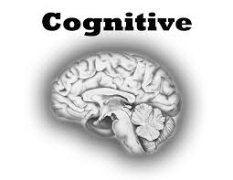


Three Learning Domains --KSA
Cognitive Domain : involves knowledge and the development of intellectual skills.
(ex: recognition of specific facts)
Affective Domain : includes the manner in which we deal with things emotionally
(ex: feelings, appreciations, etc.)
Psychomotor Domain : involves physical movement, coordination, and use of the motor skills (ex: perception & response)
20
Notes:
Taxonomy = Classification, Categorisation, arrangement.
His book is used throughout the world in the preparation of evaluation materials.

Slide 21
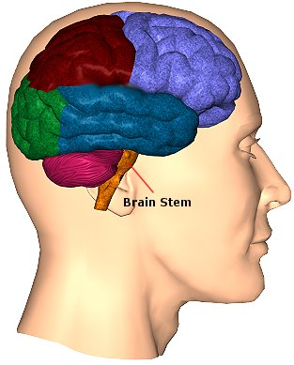
Cognitive Learning -Taxonomy
Bloom (1956) proposed that knowing is composed of six successive levels arranged in a hierarchy
6. Evaluation
5. Synthesis
4.Analysis
3. Application
2. Comprehension
1. Knowledge
In order to get to the highest level of the cognitive taxonomy, which is evaluation, the student would need to have the necessary knowledge in all the other levels below Evaluation.
21
Notes:
Our thinking can be divided into six increasingly complex levels.
Each level depends on the student’s ability to perform at the level or levels that are below it.
For a student to apply knowledge, he or she would need to have the necessary information and understand it.
Very interested in helping students to move up into the higher mental processes.
The taxonomy was not simply a classification scheme – it was an effort to arrange the various thinking processes in a hierarchy.

Slide 22
Bloom’s Expectations in various levels
Knowledge: Ability to recall ,remember facts even without clear understanding
Comprehension: Ability to interpret and able to write on their own
Application: Ability to use the concepts to solve problems in new situations
Analysis: Ability to breakdown the information in to tiny components , looking for interrelationship and organization of information
Synthesis: Ability to put parts together
Evaluation: Ability to judge the value of information

Slide 23
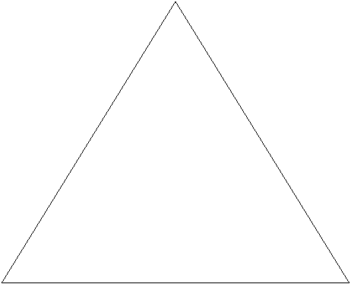
Bloom’s Triangle
Evaluation
Analysis
Synthesis
Knowledge
Comprehension
Application

Slide 24
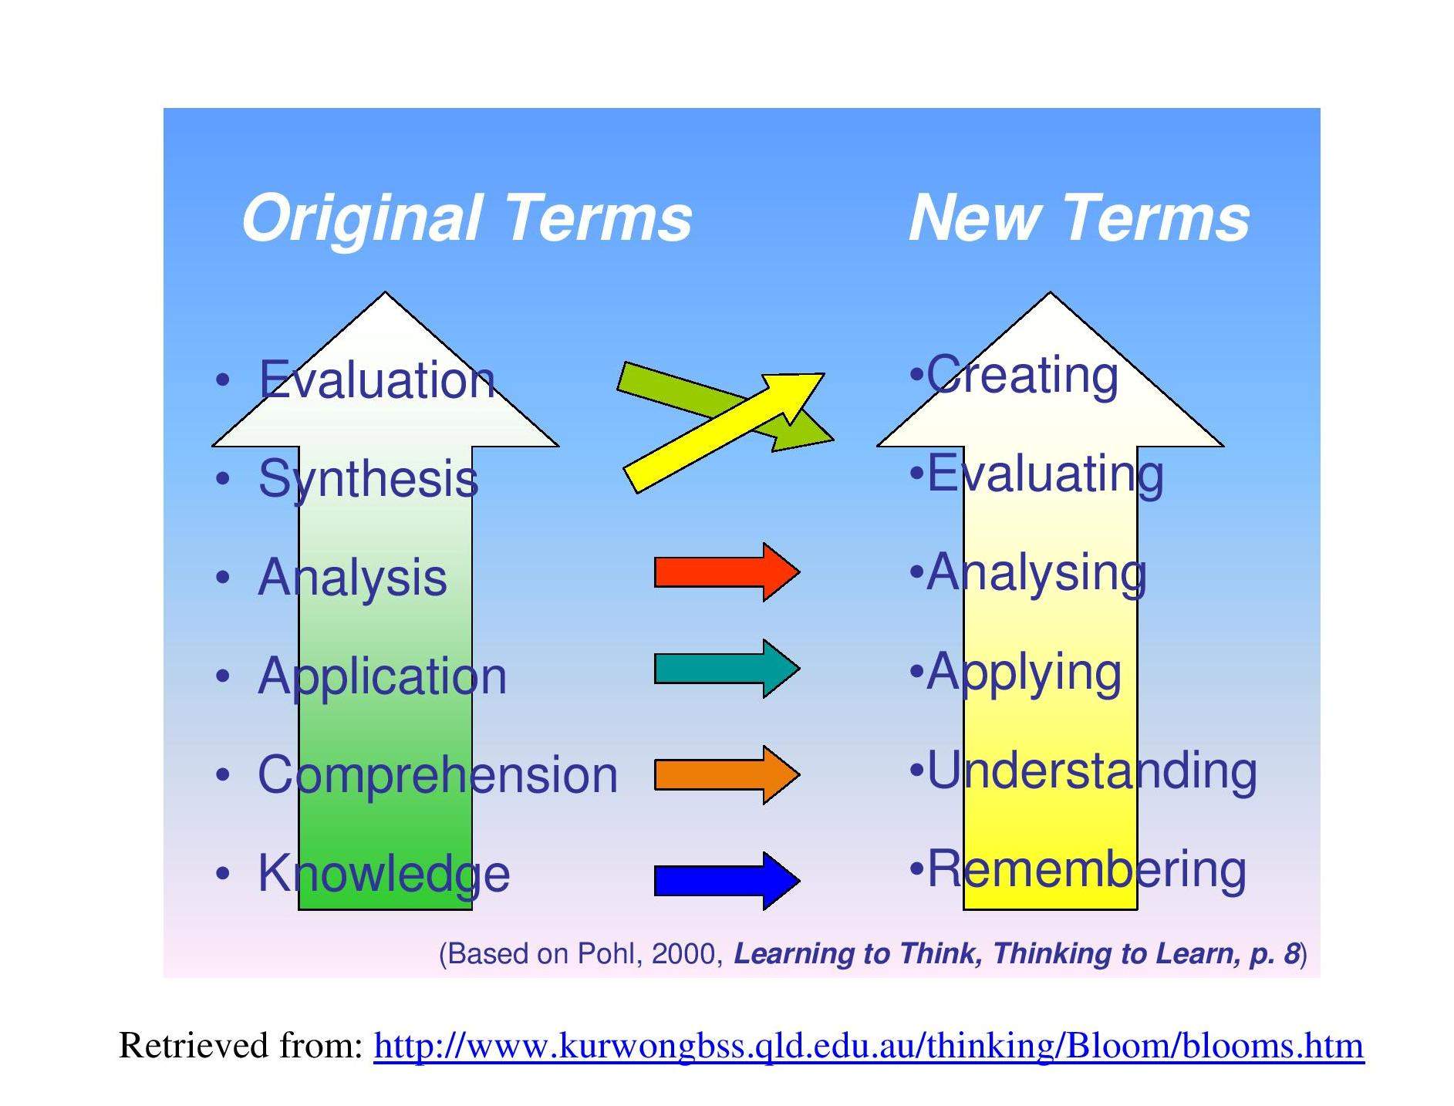
Revised Blooms Taxonomy

Slide 25
Change Terms
Nouns are converted to active process verbs
  Learning is an active process
Names of Knowledge, Comprehension and Synthesis are changed
  Knowledge is an outcome or product of thinking not a form of thinking per se
  Understand and Create is used to better reflect the nature of thinking
Two dimensional model : Knowledge dimension and cognitive processes

Slide 26
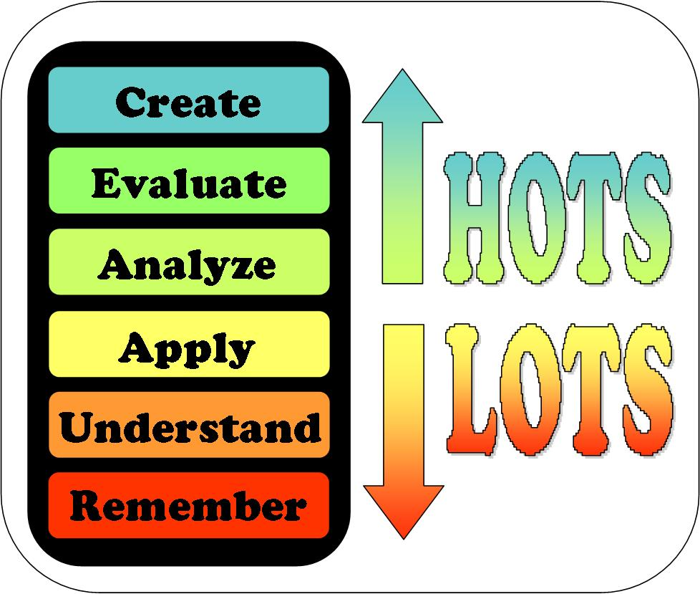

Slide 27
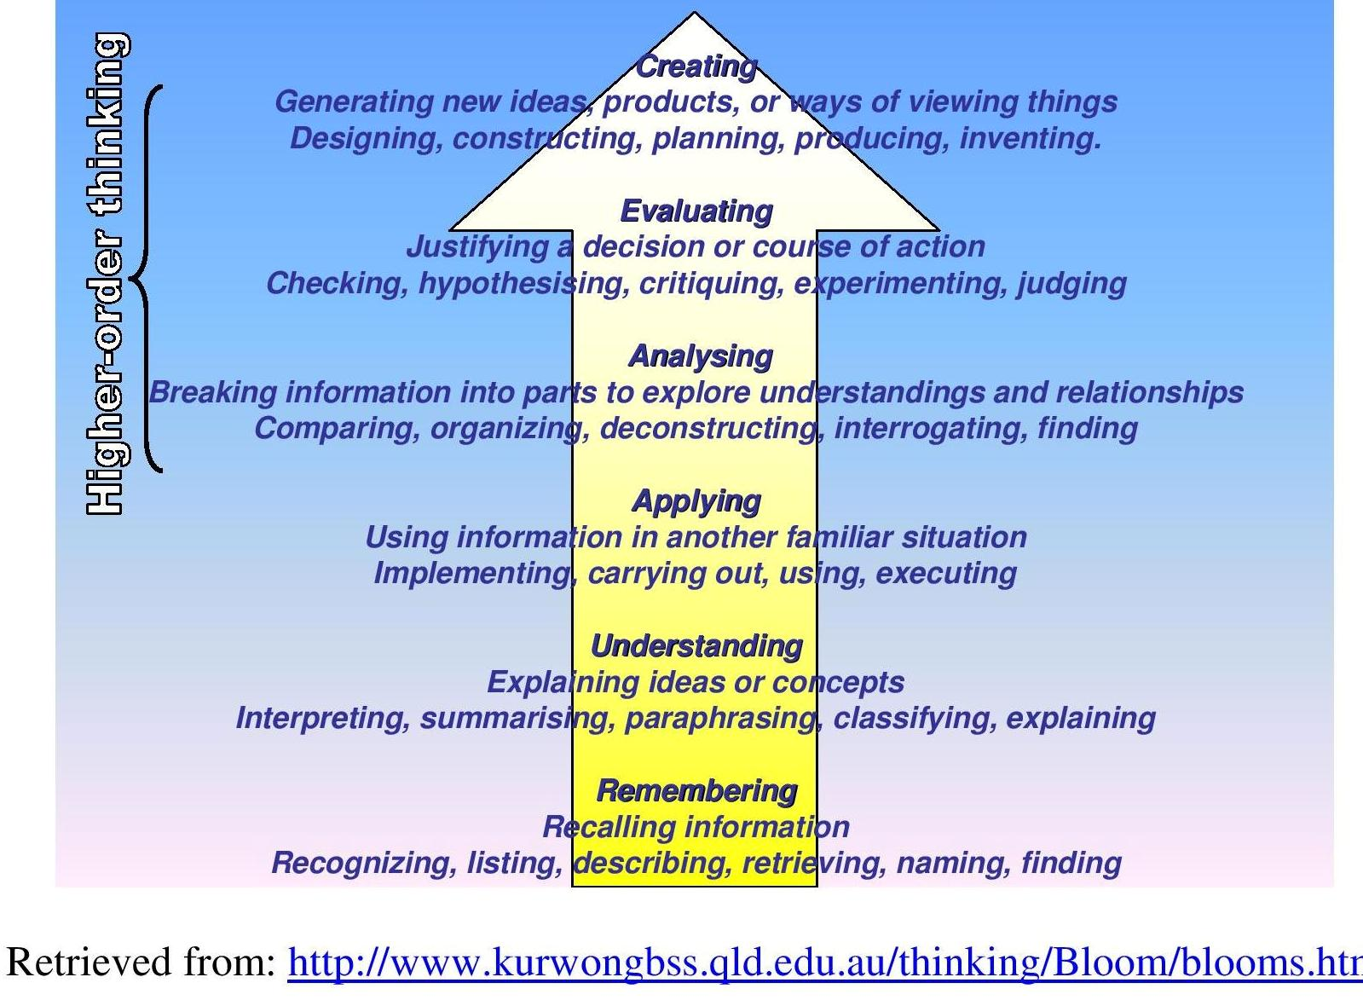
Flow diagram

Slide 28
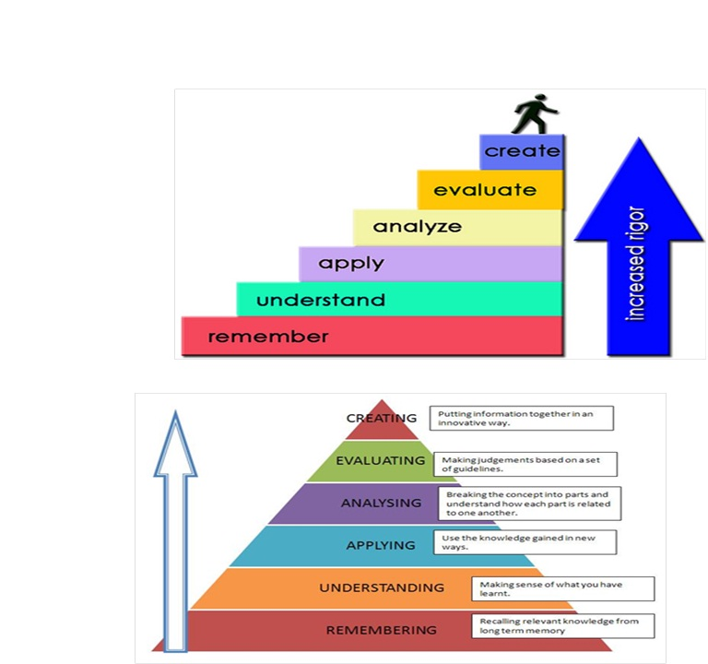

Slide 29

Remembering
The learner is able to recall, restate and remember learned information
  Describing
  Finding
  Identifying
  Listing
  Retrieving
  Naming
  Locating
  Recognizing
Can students recall information?
Notes:
Make a story map showing the main events of the story.
Make a time line of your typical day.
Make a concept map of the topic.
Write a list of keywords you know about….
What characters were in the story?
Make a chart showing…
Make an acrostic poem about…
Recite a poem you have learned.

Slide 30
Understanding
Student grasps meaning of information by interpreting and translating what has been learned
  Classifying
  Comparing
  Exemplifying
  Explaining
  Inferring
  Interpreting
  Paraphrasing
  Summarizing
Can students explain ideas or concepts?
Notes:
Write in your own words…
Cut out, or draw pictures to illustrate a particular event in the story.
Report to the class…
Illustrate what you think the main idea may have been.
Make a cartoon strip showing the sequence of events in the story.
Write and perform a play based on the story.
Write a brief outline to explain this story to someone else
Explain why the character solved the problem in this particular way
Write a summary report of the event.
Prepare a flow chart to illustrate the sequence of events.
Make a coloring book.
Paraphrase this chapter in the book.
Retell in your own words.
Outline the main points.

Slide 31
Applying
Student makes use of information in a context different from the one in which it was learned
  Implementing
  Carrying out
  Using
  Executing
c
=
Can students use the information in
another familiar situation?
Notes:
Construct a model to demonstrate how it looks or works
Practice a play and perform it for the class
Make a diorama to illustrate an event
Write a diary entry
Make a scrapbook about the area of study.
Prepare invitations for a character’s birthday party
Make a topographic map
Take and display a collection of photographs on a particular topic.
Make up a puzzle or a game about the topic.
Write an explanation about this topic for others.
Dress a doll in national costume.
Make a clay model…
Paint a mural using the same materials.
Continue the story…

Slide 32

Analyzing
Student breaks learned information into its parts to best understand that information
  Attributing
  Comparing
  Deconstructing
  Finding
  Integrating
  Organizing
  Outlining
  Structuring
Can students break information into parts to explore understandings and relationships?
Notes:
Use a Venn Diagram to show how two topics are the same and different
Design a questionnaire to gather information.
Survey classmates to find out what they think about a particular topic. Analyse the results.
Make a flow chart to show the critical stages.
Classify the actions of the characters in the book
Create a sociogram from the narrative
Construct a graph to illustrate selected information.
Make a family tree showing relationships.
Devise a roleplay about the study area.
Write a biography of a person studied.
Prepare a report about the area of study.
Conduct an investigation to produce information to support a view.
Review a work of art in terms of form, color and texture.
Draw a graph
Complete a Decision Making Matrix to help you decide which breakfast cereal to purchase

Slide 33
Evaluating
Student makes decisions based on in-depth reflection, criticism and assessment
  Checking
  Critiquing
  Detecting
  Experimenting
  Hypothesising
  Judging
  Monitoring
  Testing
Can students justify a decision or a course of action?
Notes:
Write a letter to the editor
Prepare and conduct a debate
Prepare a list of criteria to judge…
Write a persuasive speech arguing for/against…
Make a booklet about five rules you see as important. Convince others.
Form a panel to discuss viewpoints on….
Write a letter to. ..advising on changes needed.
Write a half-yearly report.
Prepare a case to present your view about...
Complete a PMI on…
Evaluate the character’s actions in the story

Slide 34

Creating
Student creates new ideas and information using what previously has been learned
  Constructing
  Designing
  Devising
  Inventing
  Making
  Planning
  Producing
Can students generate new products,
ideas, or ways of viewing things?
Notes:
Use the . . . strategy to invent a new type of sports shoe.
Invent a machine to do a specific task.
Design a robot to do your homework.
Create a new product. Give it a name and plan a marketing campaign.
Write about your feelings in relation to...
Write a TV show play, puppet show, role play, song or pantomime about..
Design a new monetary system
Develop a menu for a new restaurant using a variety of healthy foods
Design a CD, book or magazine cover for...
Sell an idea
Devise a way to...
Make up a new language and use it in an example
Write a jingle to advertise a new product.
(Adapted from Dalton, 1986)

Slide 35
Blooms Knowledge Levels
We must remember a concept before we can understand it.
We must understand a concept before we can apply it.
We must be able to apply a concept before we analyze it.
We must have analyzed a concept before we can evaluate it.
We must have remembered, understood, applied, analyzed, and evaluated a concept before we can create.

Slide 36
Recommended Blooms Action Verbs
Remember- List, Define, State, Write, Identify, Recall, Tabulate, show, recite, Name, Quote
Understand- Describe, Explain, Illustrate, compare, paraphrase, convert, restate, associate, interpret, contrast, summarize
Apply- Apply, Use, Solve, Calculate, Compute, Find, Solve, predict, demonstrate ,determine, model
Analyze- Analyze, Justify, Organize, categorize, infer, classify
Evaluate- Evaluate, Choose, Select, Judge, examine, Assess, Decide, Conclude, Recommend, Argue
Create- Create, Propose, Produce, Plan, Build, invent , compose

Slide 37
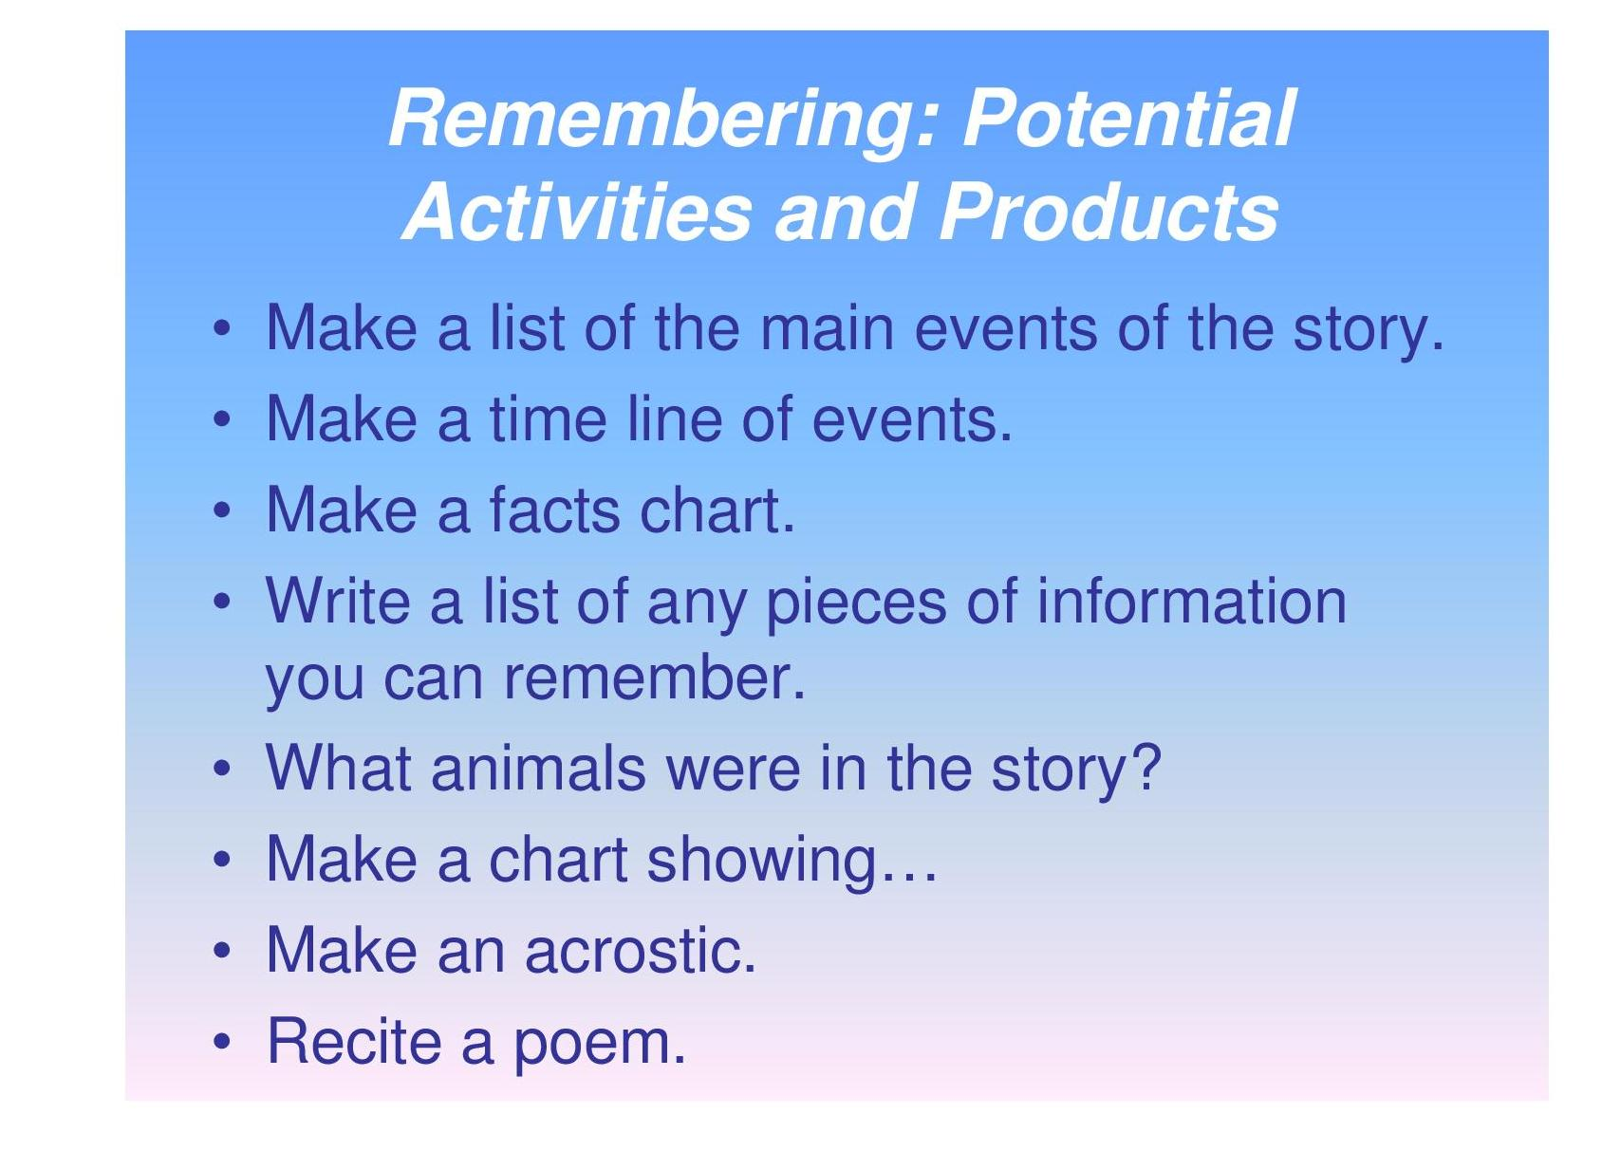
Potential activities and Products

Slide 38
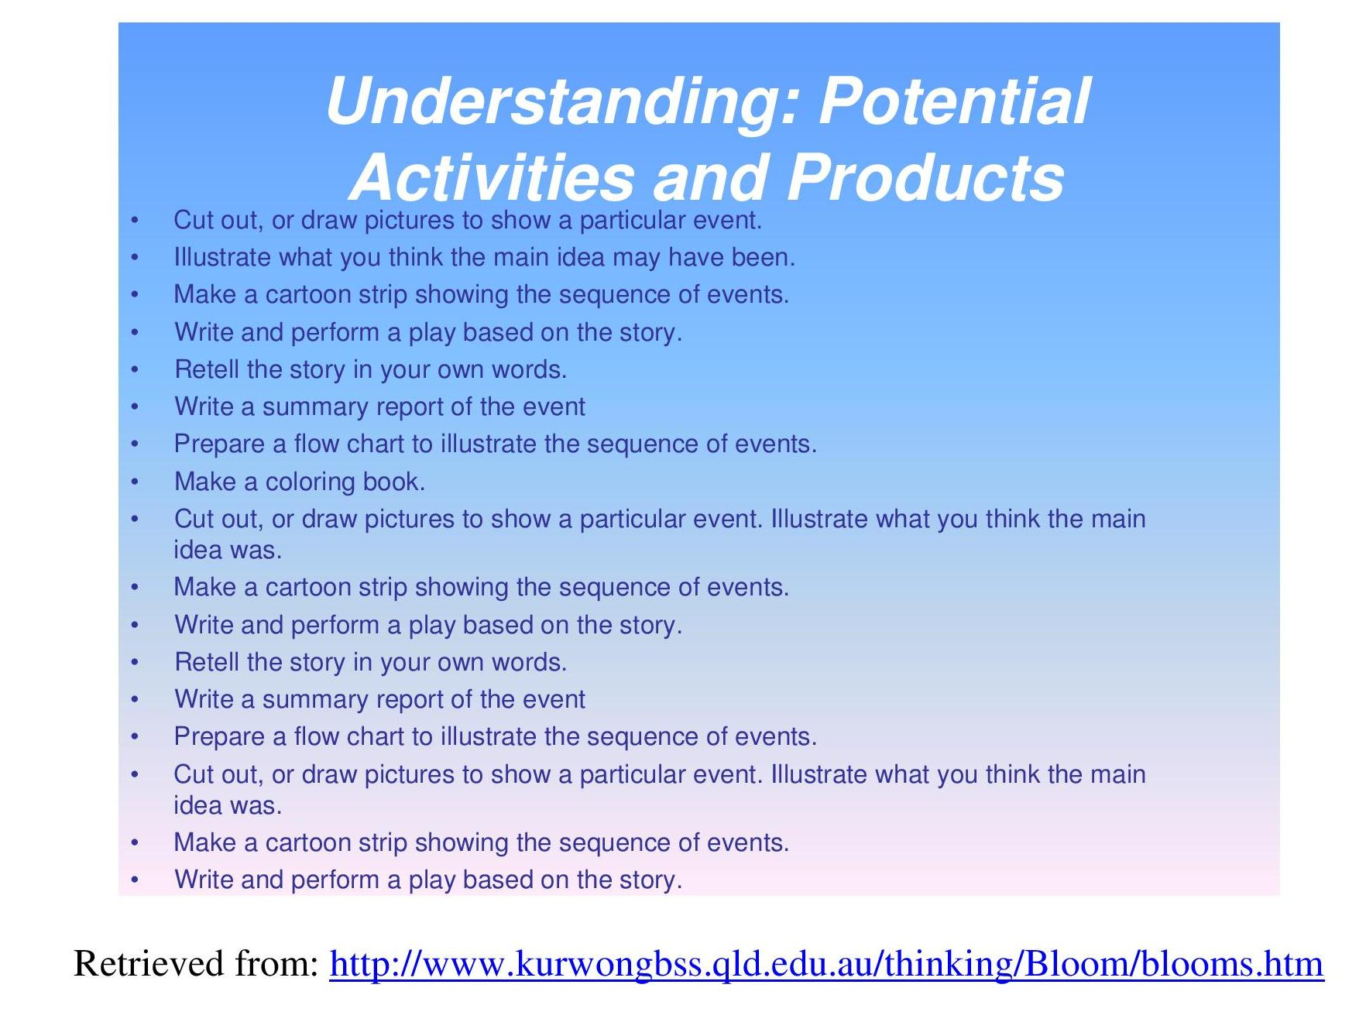
Potential activities and Products (Contd.,)

Slide 39
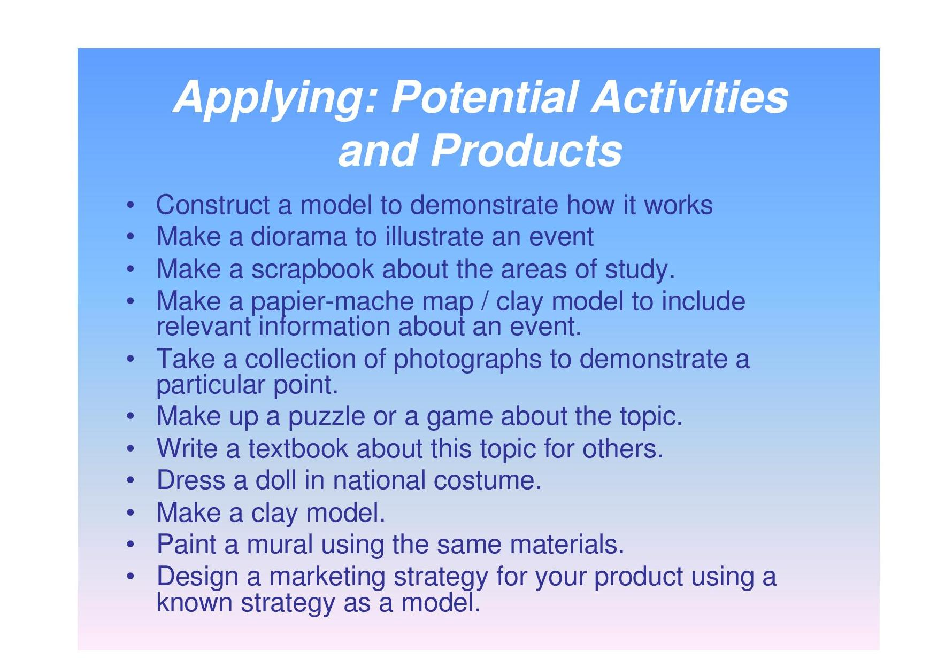

Slide 40
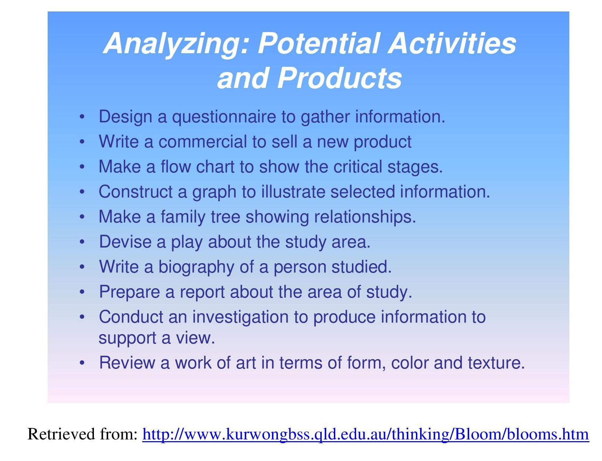

Slide 41
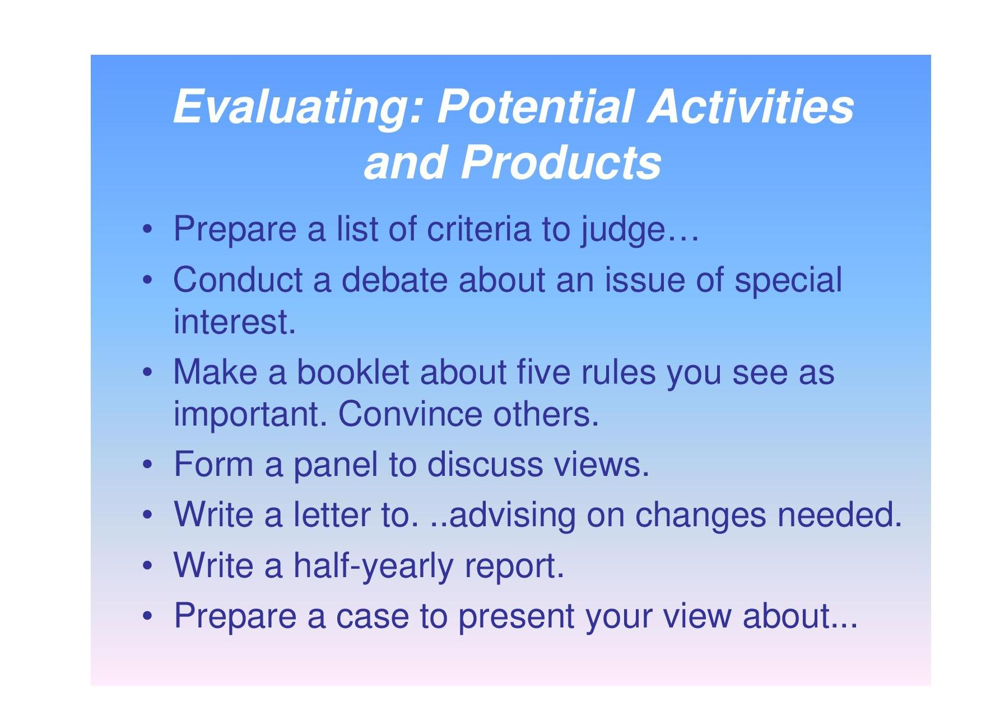

Slide 42
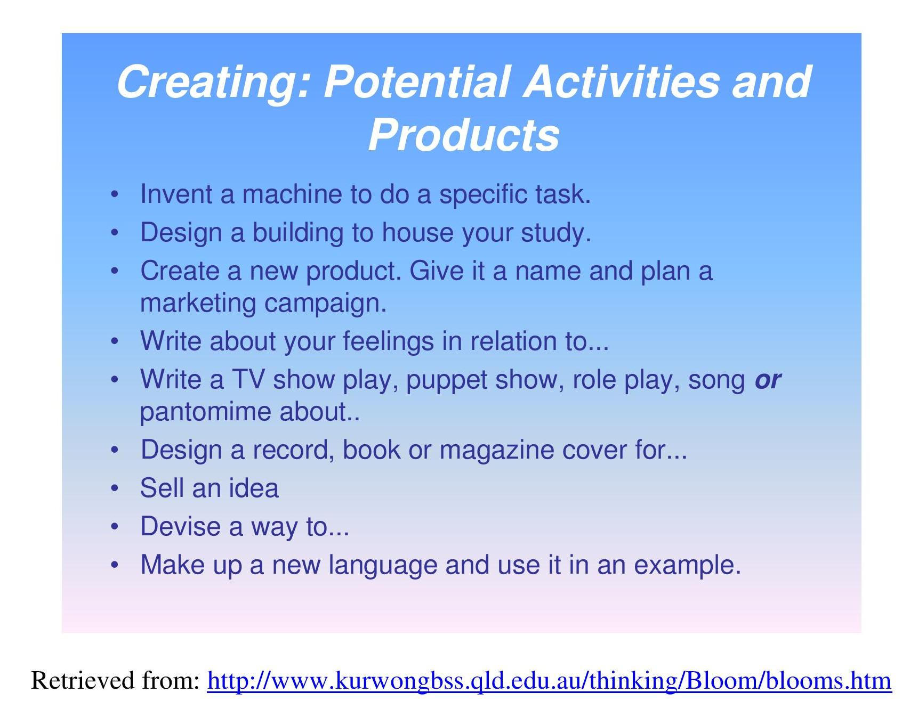

Slide 43
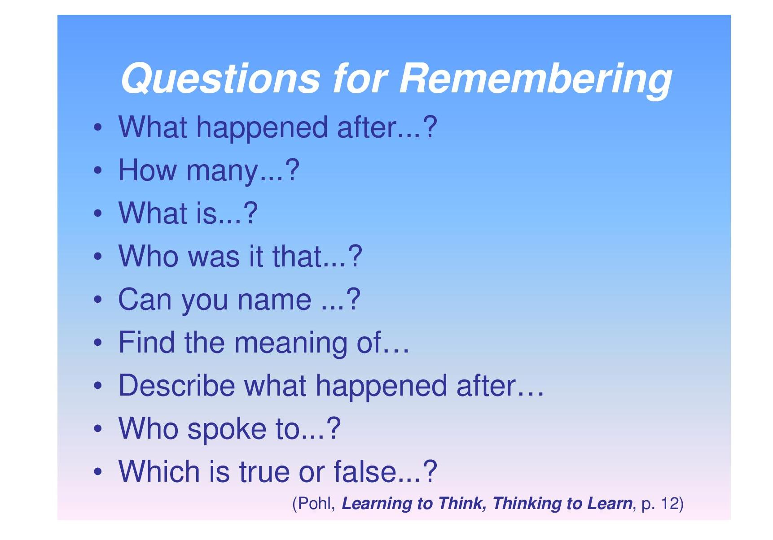
Assessment

Slide 44
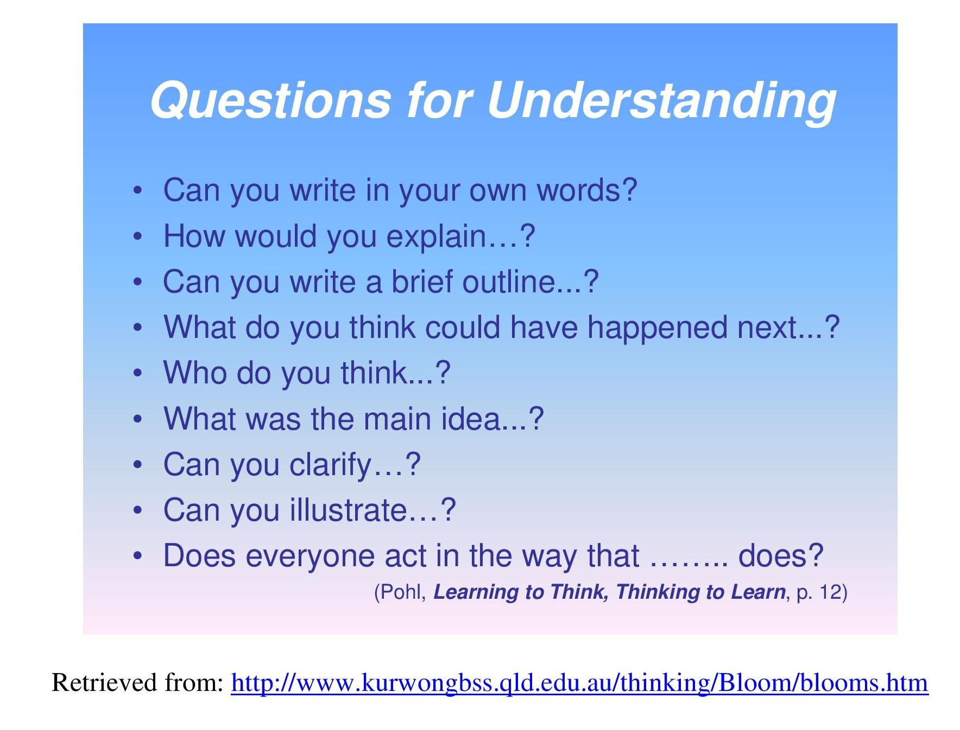

Slide 45
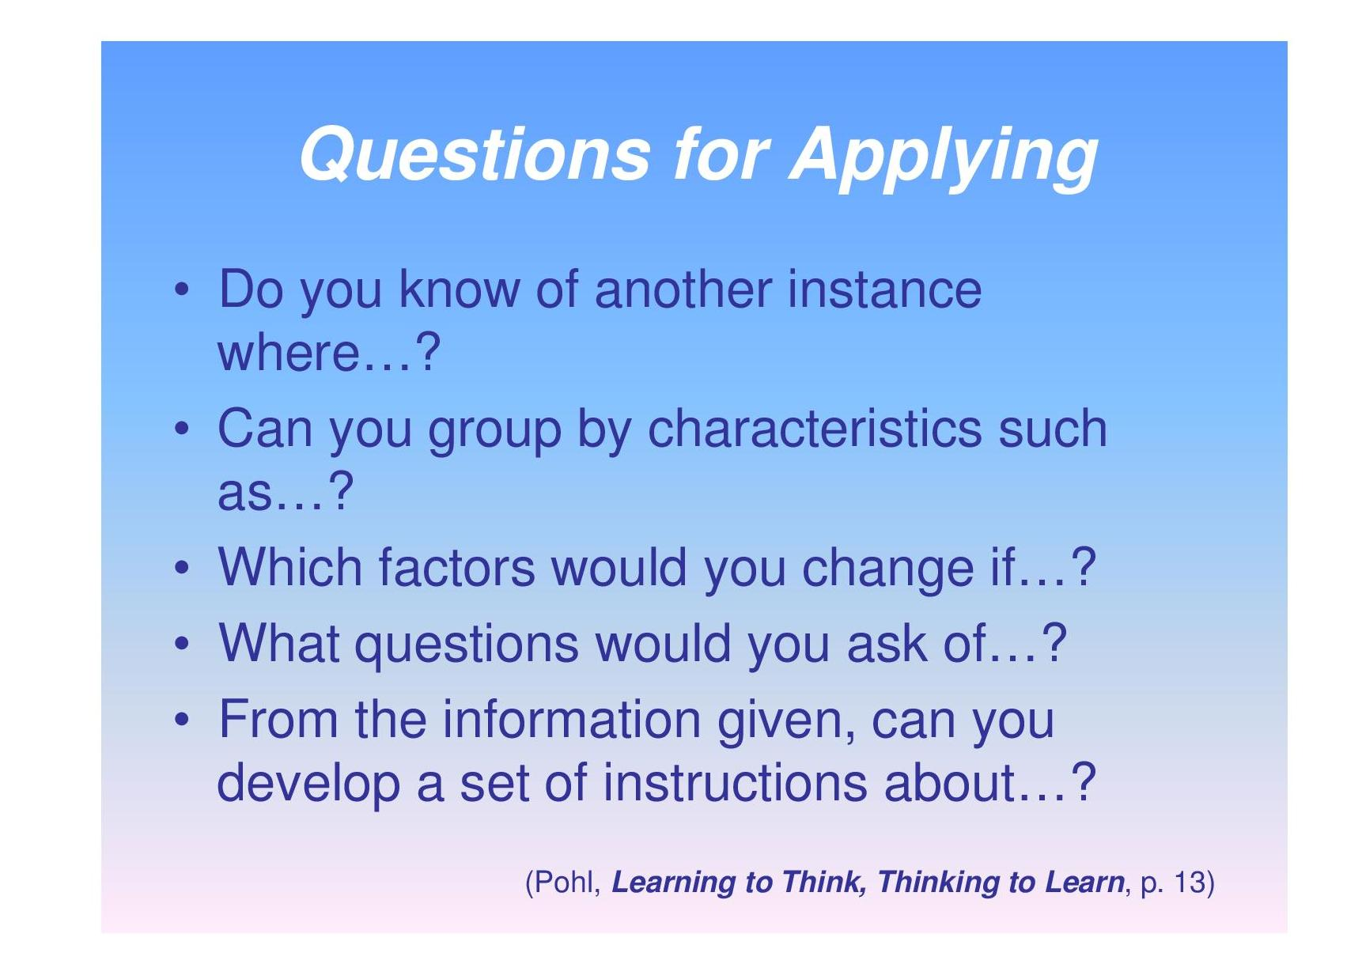

Slide 46
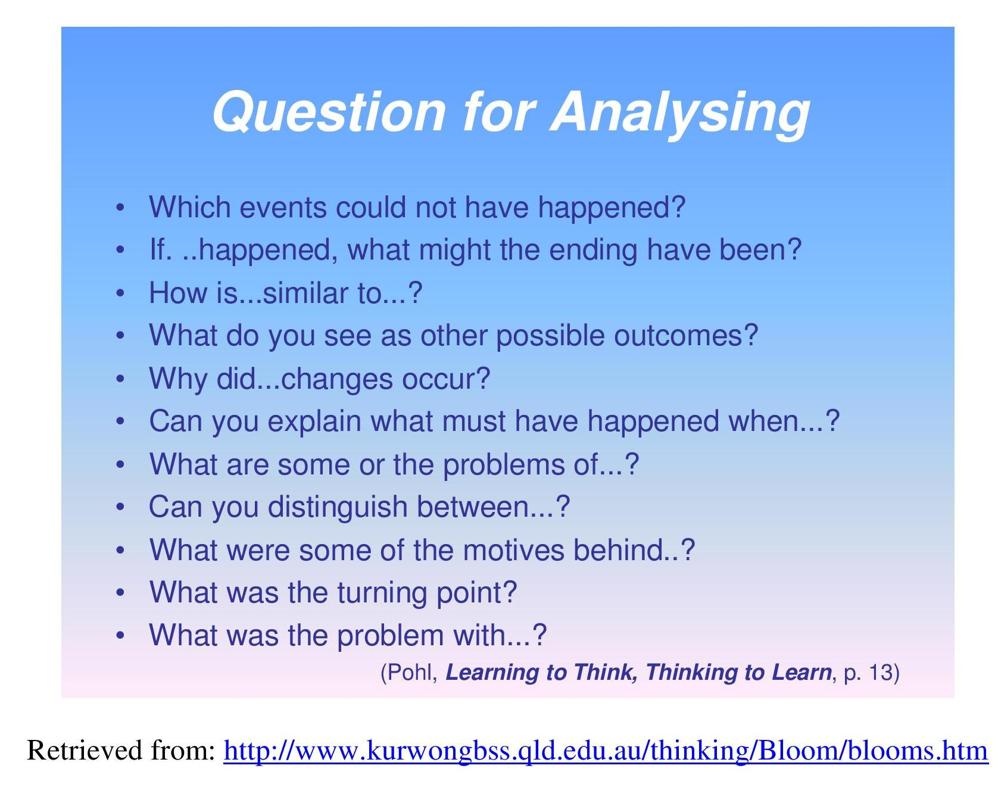

Slide 47
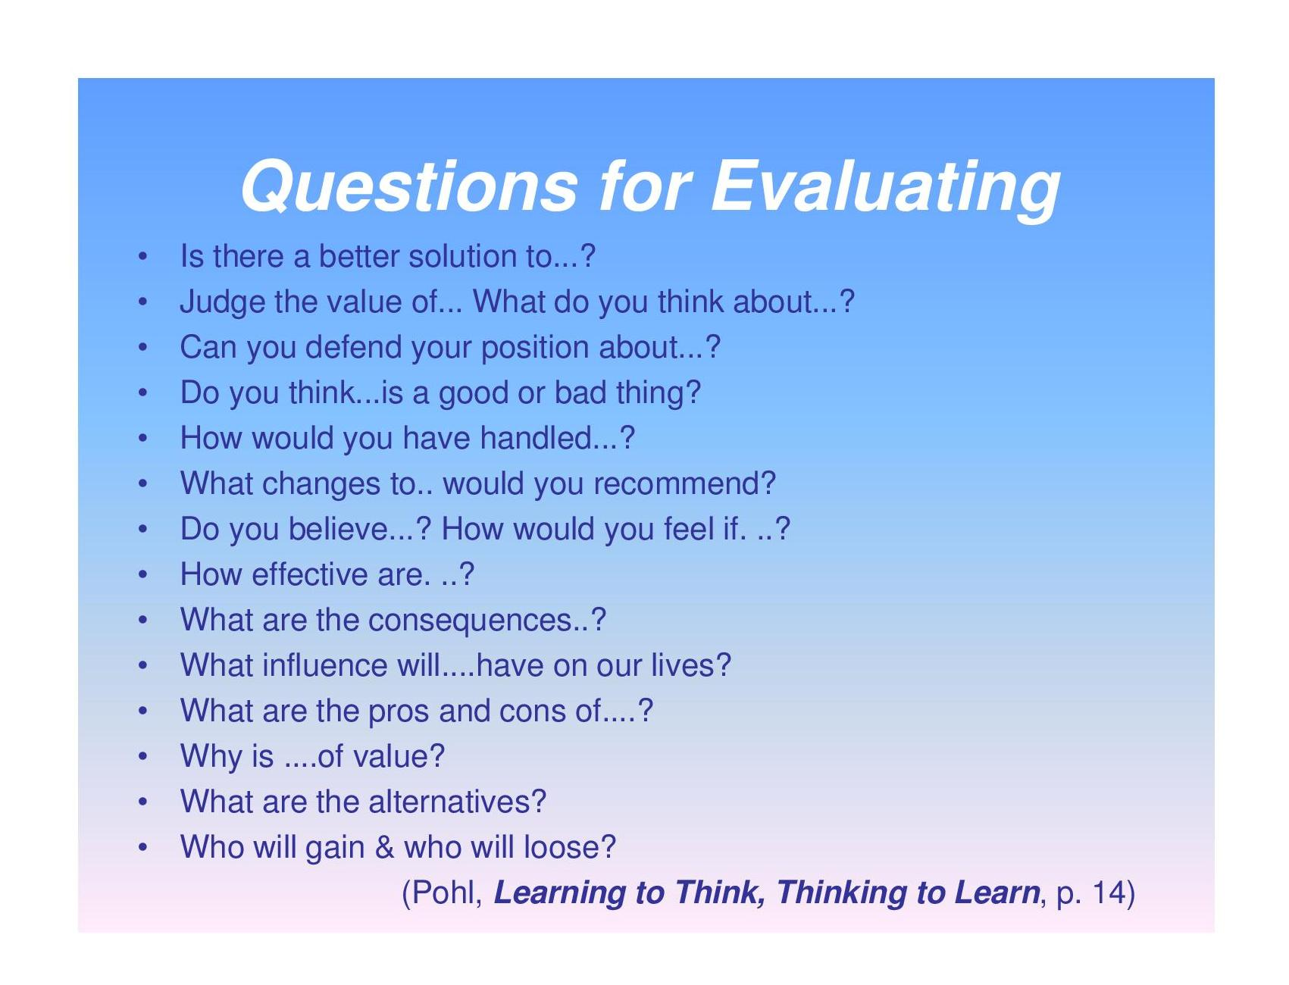

Slide 48
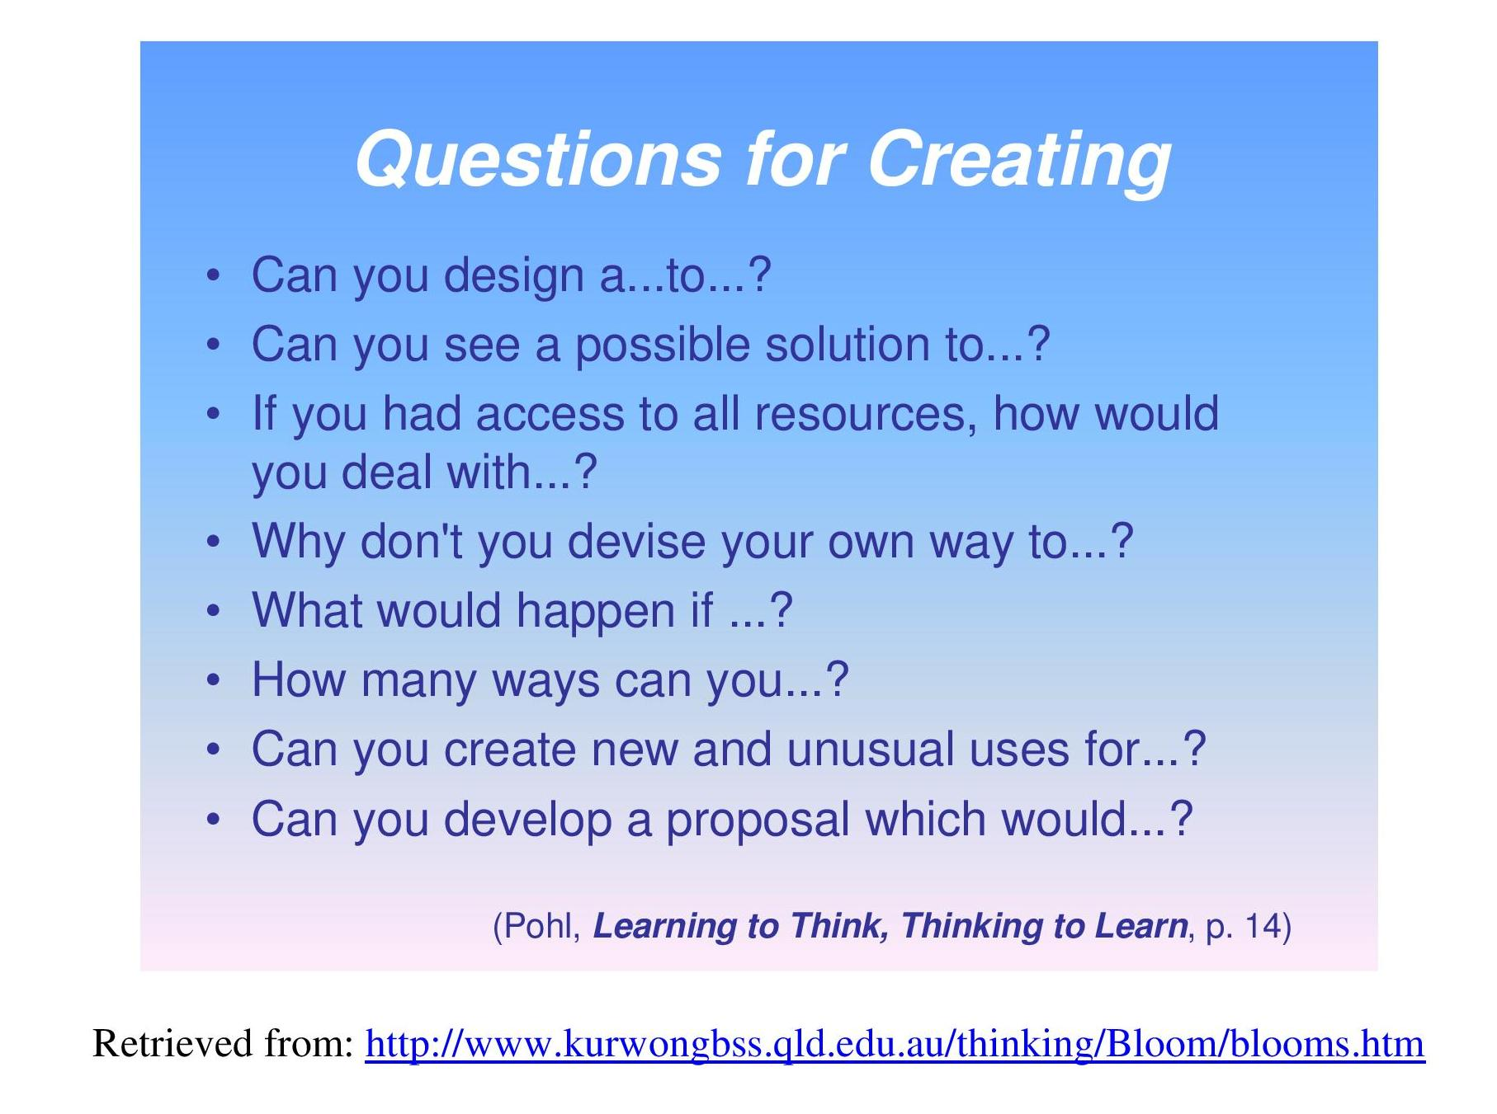

Slide 49
AFFECTIVE DOMAIN
Emotion and Cognition are inextricably linked and perhaps never entirely separate, distinctive nor pure.
~William James
The separation of the head from the heart has contributed to a fractured education system that produces minds that do not know how to feel and hearts that do not know how to think.
~Parker Palmer
49
Notes:
This could be used in the area of keeping attendance records to judge the commitment of students in attending lectures.

Slide 50
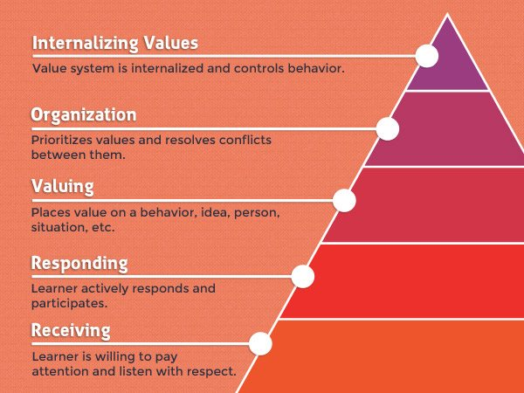

Slide 51
Blooms’ Taxonomy…
  Affective Domain:
  Receiving (Attending)
    Learners willingness to receive information
      Ask, accept, hold
  Responding
    Active Participation
      Not just willing to attend, but are actively attending
      Answer, assist, discuss
  Valuing
    This level ranges from acceptance of a value, to preference, to commitment to a value
      Embrace, follow, join, share, value

Slide 52
Blooms’ Taxonomy…
  Affective Domain…
  Organizing
    Organization of values into a system, determining the relationship among them, and establishing dominant and pervasive values
      Alter, combine, complete, integrate, order, organize, relate, synthesize
  Characterizing
    Individual acts consistently in accordance with the values he/she has internalized
      Discriminate, display, influence, presuppose, qualify, resolve, solve, verify

Slide 53
Affective Domain: Action Verbs
Receiving | Responding | Valuing | Organizing | Characterizing
Students become aware of an attitude, behavior, or value. | Students exhibit a reaction or change as a result of exposure to an attitude, behavior, or value. | Students recognize value and display this through involvement or commitment. | Students determine a new value or behavior as important or a priority. | Students integrate consistent behavior as a naturalized value in spite of discomfort or cost. The value is recognized as a part of the person’s character.
Accept Attend Describe Explain Locate Observe Realize Receive Recognize | Behave Comply Cooperate Discuss Examine Follow Model Present Respond Show | Accept Adapt Balance Choose Differentiate Defend I Influence Prefer Recognize Seek Value | Adapt Adjust Alter Change Customize Develop Improve Manipulate Modify Practice Revise | Authenticate Characterize Defend Display Embody Habituate Internalize Produce Represent Validate Verify

Slide 54
Examples of
Course Outcomes in Affective Domain
Accept the need for professional ethical standards.
Appreciate the need for confidentiality in the professional client relationship.
Display a willingness to communicate well with clients .
Relate to participants in an ethical and humane manner.
Resolve conflicting issues between personal beliefs and ethical considerations.
Embrace a responsibility for the welfare of children taken into care.
Participate in class discussions with colleagues and with teachers.
54

Slide 55
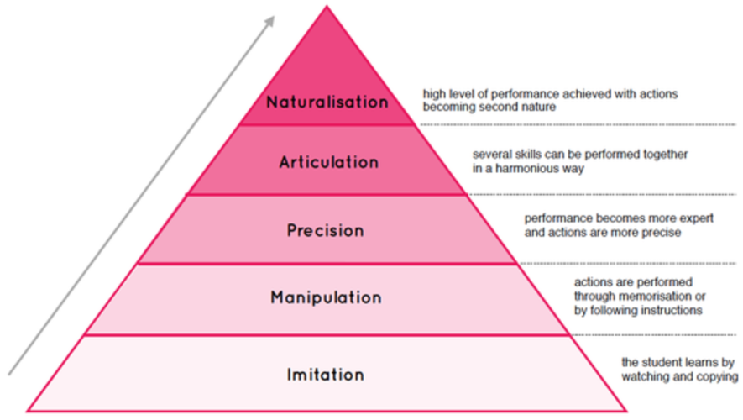
Psychomotor –Dave’s(1970)

Slide 56
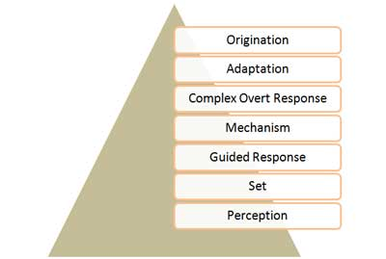
Psychomotor Domain –Simpson(1972)

Slide 57
  Taxonomy…
  Psychomotor Domain:
  Perception
    Ability to use sensory cues to guide motor activity
  Set (Physical, emotional and mental)
    Readiness to take a particular course of action
  Guided Response (Imitation and trail & Error)
    Performance is judged by instructor or a by a set of criteria
  Mechanism
    Learned Responses – Habitual
    Movements – some confidence and Proficiency

Slide 58
  Blooms’ Taxonomy
  Psychomotor Domain:
  Complex Overt Responses (Automatic)
    Skillful Responses – Complex Movement Pattern
    Proficiency
  Adaptation
    Can modify movement patterns to meet a problem situation
  Origination
    Creation of new movement pattern
    Creativity based on highly developed skills

Slide 59
Laboratory skills
Operate the range of instrumentation specified in the module safely and efficiently in the electronics laboratory.
Perform load test of an electrical machine accurately and safely in the laboratory.
Construct simple hardware interfacing diagram for a microprocessor based system.
Presentation skills
Deliver an effective presentation.
Demonstrate a range of graphic and CAD communication techniques.
59

Slide 60
Educational Implications of Blooms Taxonomy
provides a universally effective strategy for
creating all type of content to impart learning.
helps teachers make decisions about the
classification of content and map content to
tasks that students need to perform.
guides teachers to develop higher levels of
thinking process for critical thinking or creative
thinking.

Slide 61
Educational Implications of Blooms Taxonomy
teacher develops questions or projects that require the development of thinking and reflection from the knowledge level to the evaluation level.
teacher or a syllabus designer designs a curriculum as well as classroom assignment using Bloom’s taxonomy to advance the learning process from recalling learning materials to higher level of thinking.
teacher creates class activities based on Bloom’s Taxonomy.

Slide 62
Educational Implications of Blooms Taxonomy
teacher develops questions or projects that require the development of thinking and reflection from the knowledge level to the evaluation level.
teacher or a syllabus designer designs a curriculum as well as classroom assignment using Bloom’s taxonomy to advance the learning process from recalling learning materials to higher level of thinking.
teacher creates class activities based on Bloom’s Taxonomy.

Slide 63
Summary
Bloom’s revised taxonomy
Systematic process of thinking & learning
Assists assessment efforts with easy-to-use format
Visual representation of alignment between goals & objectives with standards, activities, & outcomes
Helps form challenging questions to help students gain knowledge & critical thinking skills
Assists in development of goals, objectives, & lesson plans
Notes:
GOLDILOCKS STORY

Slide 64
Thank You!
Discussion and Questions

Slide 65
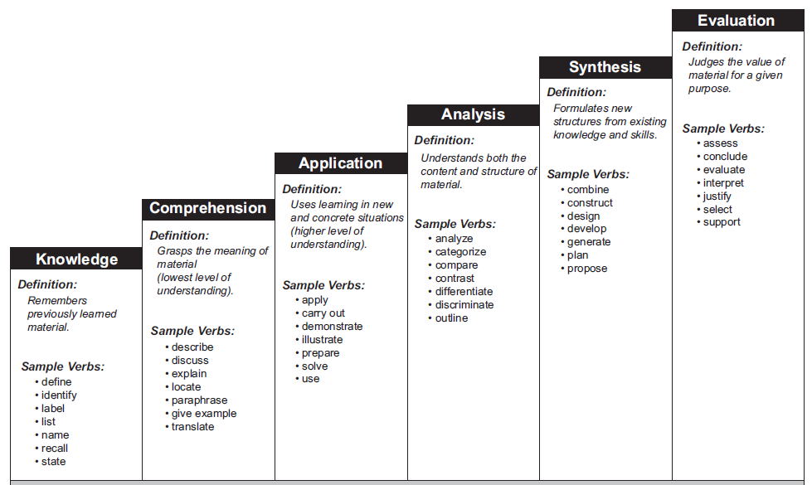
COGNITIVE DOMAIN Action Verbs

Slide 66
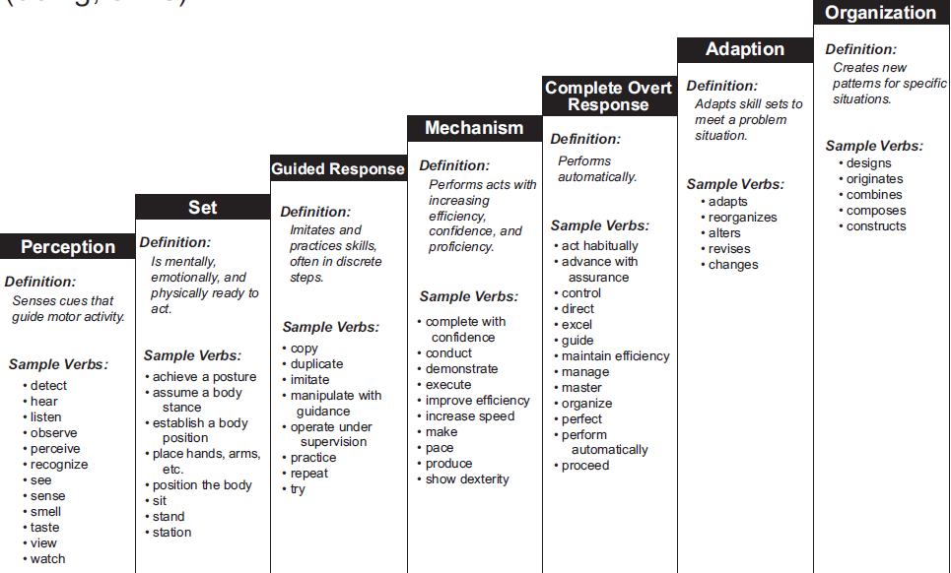
PSYCHOMOTOR DOMAIN Action Verbs

Slide 67
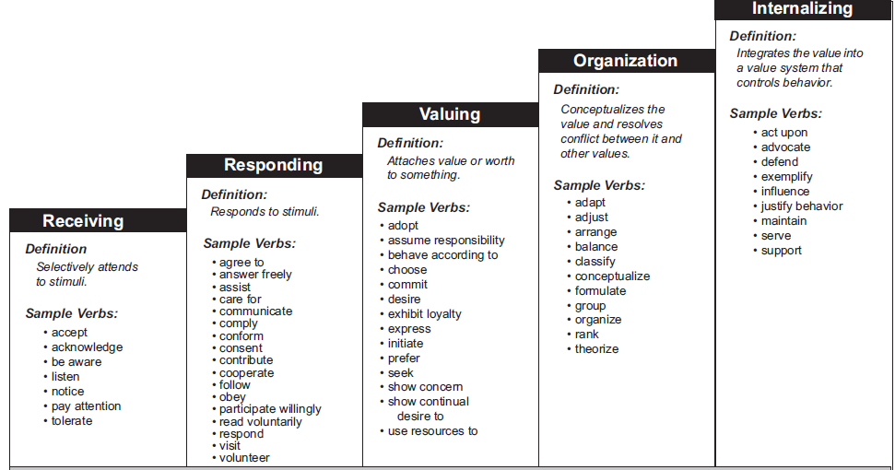
AFFECTIVE DOMAIN Verbs

Slide 68
Assessment Items
Wide choice
Many more types than the popular Closed-Book Examinations and Quizzes
Key is to align assessment to Course outcomes and Program outcomes
Needs considerable effort
Follow planning of outcomes & prior to design of instruction!

Slide 69
Classification of Assessment methods
• Selection vs. Supply
• Objective vs. Subjective
• Written vs. Performing
• Formative vs. Summative
• Closed vs. Open
Direct vs indirect

Slide 70
Selection vs. Supply - 1
Selection:
  Students select from a given list of responses
  Unique answers
  Mostly objective
  Easy to automate & compare
  Can cover “more syllabus”
  Generally assesses lower levels of cognition ( Ex: MCQ, T/F, match, … )
Supply:
  Students create and provide the response
  Answers may not be unique
  Non-uniform & time-consuming evaluation
  Difficult to cover “more syllabus”
  Can assesses all levels of cognition
  Most common in conventional written examinations!

Slide 71
Objective vs. Subjective
Objective:
  Unique answers, typically Select type
  “Fill In” possible with unique answer
  All the advantages of Select!
Subjective:
  Responses need not be unique
  Typically Supply type, but Fill In kind
  possible if multiple responses are
  possible
  Difficulties similar to Supply type!

Slide 72
Written vs. Performing
Written:
  As name implies, responses are written in exam setting (any combination of select / supply; objective/subjective is possible)
Performing:
  Based on performance; Project, Group discussion, Presentation etc
  Assessment needs more planning

Slide 73
Formative vs. Summative
Formative:
  Also called educative, classroom and some times diagnostic assessment
  Used for adapting instruction and or learning!
  Purely formative is rare!!
Summative:
  Summarize student accomplishment
  Directly reflected in Grades
  Can be used for improvements also

Slide 74
Closed vs. Open
Closed:
  Most common; Student has no access to other resources for responding (excluding “data” of course)
  Can be at any LOTs
Open:
  Access to other resources
  No unique solutions generally
  Used to assess higher cognitive levels

Slide 75
Content delivery
Lecture
Lecture with discussion
Demonstrations
Group discussion
Debate
Technical Quiz
Seminar
Mini-project
Asynchronous discussions

Slide 76
Assessment methods and tools
Direct Assessment Method: using measurable performance indicators of students
  Exams
  Assignments
  Projects
  Tutorials
  Labs
  Presentations
Indirect Assessment Method: Ascertaining opinion or self-reports
  Alumni survey
  Employer survey
  Exit survey
  Course-end survey, etc.,.
76

Slide 77
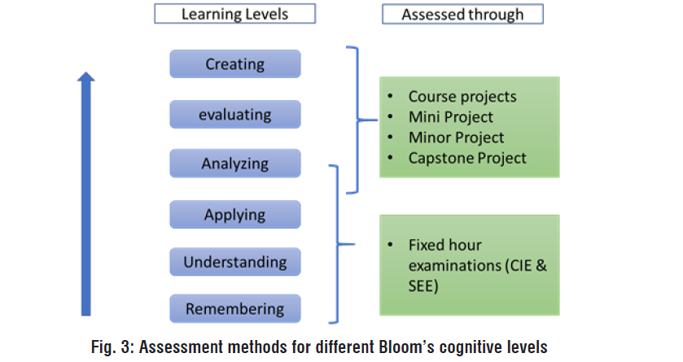
Assessment methods and KL

Slide 78
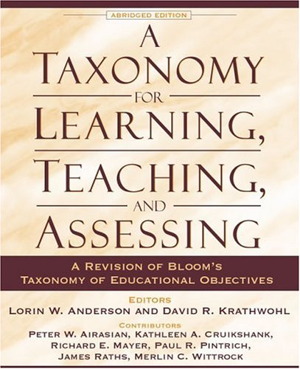

Slide 79
References
Bloom Benjamin S. and David R. Krathwohl. Taxonomy of Educational Objectives: The Classification of Educational Goals, by a committee of college and university examiners. Handbook I: Cognitive Domain. New York, Longmans, Green, 1956.
Bloom, B.S., Masia, B.B. and Krathwohl, D. R. (1964). Taxonomy of Educational Objectives Volume II : The Affective Domain. New York: McKay.
Bloom, B.S. (1975) Taxonomy of Educational Objectives, Book 1 Cognitive Domain. Longman Publishing.
Krathwohl, David, R. (2002) A Revision of Bloom’s Taxonomy: An Overview. Theory into Practice, 41 (4).

Slide 80
THANK YOU

